Slide 1
Fourier Optics
27th November 2018

Slide 2
Concepts of spatial period and spatial frequency (1)
Consider an optical information spreading across a region of space at a fixed location in time.
Fig (a) is an example of the optical information as two-dimensional flux-density distribution.
A value of intensity I to each point on the picture; i.e. illuminated transparency, a television picture or an image projected on a screen, may be given as I(y,z).
Given I(y,0): irradiance scanned across a distance y as shown in Fig (b).
Rather complicated functions are needed to synthesize I(y,0).
The synthesis can be done once the functional form of I(y,0) is known.
Notes:
Electrical signal normally varies in time at some fixed location in space.
spatial frequency is a characteristic of any structure that is periodic across position in space.

Slide 3
Concepts of spatial period and spatial frequency (2)
Now let’s scan across the distance y but at z = a (Fig. (a)).
The irradiance is now given as I(y, a) and the flux-distribution turns out to be a series of equally spaced square pulses.
The corresponding Fourier components are shown in Fig. (d).
If the peaks in Fig. (c) are separated, center to center, by 1-cm intervals, the spatial period equal 1 cm per cycle, and its reciprocal, which is the spatial frequency, equal 1 cycle per cm.
The SI unit of spatial frequency is cycles per meter.

Slide 4
Fourier transform
The previous optical information associated with any scan line can be Fourier transformed into a series of sinusoidal functions of appropriate amplitude and spatial frequency.
Two dimensional distribution can have identical horizontal scan line at any value of z for particular functional form such as sine-wave and square wave forms.
Sine-wave
Square-wave
TRY THIS!

Slide 5
Fourier-transform pair : spatial position x and angular spatial frequency k
Since the optical information under investigation is spatial distributed, the Fourier transform pair involves spatial position x and angular spatial frequency k.
Fourier-transform pair in one dimension can be written as
F(k) is the Fourier transform of f(x).
Notes:
Angular spatial frequency is given as 2pi/spatial period

Slide 6
Example : Transform of the Gaussian function
Evaluate the Fourier transform of the Gaussian probability function,
An example of the bell-shaped curve is the cross-sectional irradiance distribution of a laser beam in the TEM₀₀ mode.
If the standard deviation is defined as the range of the variable (x or k) over which the function drops by a factor of e^{-1/2} of its maximum value. Determine σ_{x} and σ_{k}.
Notes:
Determine σ_{x} and σ_{k} (1/sqrt(2a), sqrt(2a))
As a increases, f(x) becomes narrower, in contrast, F(k) broadens. In other words, the shorter the pulse length, the broader the spatial frequcy bandwidth.

Slide 7
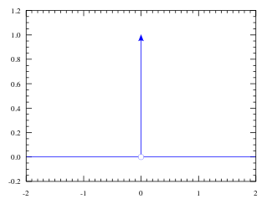
The Dirac Delta Function
In the space domain, an extremely small bright source of light embedded in a dark background is highly localized, two-dimensional, spatial pulse-a spike irradiance.
A convenient idealized mathematical representation of this sharply peaked stimulus is the Dirac delta function δ(x).
This is an infinitely narrow pulse on x = 0. It is also known as the unit impulse function.
https://en.wikipedia.org/wiki/Dirac_delta_function

Slide 8
The sifting property of δ function
Generally, with the shift of origin of an amount x₀, the delta function can be written as
This leads to a general form of the sifting property of the delta function,

Slide 9
Example : Fourier transform of δ function
Determine the Fourier transform of
Determine the Fourier transform of
3) If x₁ = +a/2 and x₂ = -a/2,
determine the Fourier transform of
(if j →∞, this summation represents a comb function)

Slide 10
Fourier transform of two symmetrical and asymmetrical δfunctions
Two delta functions and their cosine-function transform
Two delta functions and their sine-function transform
This shows that the Fourier transform of two symmetrical delta functions gives a cosine function.
Also the Fourier transform of real and even function will also be real and even.
TRY THIS! : Calculate the Fourier transform of f(x)
Notes:
The Fourier transform of two symmetrical delta functions is a cosine function.
This gives the idea of the Fourier transform of aperture function (ในที่นี้คือ symmetrical delta functions)
ให้ interference pattern บนฉาก

Slide 11
Two dimensional transform
Optics generally involved two-dimensional signal: for example, the field across an aperture or the flux-density distribution over and image plane.
The Fourier transform pair take the form,
Where k_{x} and k_{y} are angular spatial frequencies.
Any non periodic function of
two variables f(x,y) can be synthesized
From a distribution of plane waves,
each with amplitude F(k_{x},k_{y}) and
constant phase.

Slide 12
Fraunhofer diffraction (1)
Consider the Fraunhofer diffraction pattern due to an arbitrary aperture situated in an xy-plane.
Plane monochromatic waves diffract from the aperture (xy) plane.
The diffraction pattern is observed in the XY-plane, called “spectrum plane”, a distance Z along the axis.
The contribution dE_{p} at an arbitrary point P due to the light amplitude from an elemental area da surrounding point O in aperture is given by
Fraunhofer diffraction in the spectrum XY-plane due to an aperture in the xy-plane.
Notes:
EA = amplitude per unit area.

Slide 13
Fruaunhofer diffraction (2)
Recall the contribution of electric field dE_{p} at point P on spectrum plane.
Amplitude of the contribution term decreases with distance r (distance from point O to point P).
The illumination of the aperture may be non-uniform and generally given as E_{A} = E_{A}(x,y).
According the figure in the previous page, r can be approximately given as
By substituting r in the phase of dE_{p} and r in amplitude with Z,
Upon integration over the area of the aperture, thus

Slide 14
Example
From the figure,

Slide 15
Fraunhofer diffraction (3)
Define the relative amplitude distribution A_{p} of the electric field in the spectrum plane.
Also, introduction the angular spatial frequencies,
This gives
This shows that the amplitude distribution or Fraunhofer diffraction pattern A_{p} (k_{X},k_{Y}) actually is the 2D Fourier transform of the aperture function E_{A} (x,y).
This also reveals that the inverse transform gives
Notes:
The key point : the field distribution in the Fraunhofer diffraction pattern is the Fourier transform of the field distribution across the aperture (i.e., the aperture function)

Slide 16
Fourier method in diffraction theory
We have arrived at the key point: the field distribution in the Fraunhofer diffraction pattern is the Fourier transform of the field distribution across the aperture (i.e., the aperture function)
For each point on the image plane (spectrum plane), there is a corresponding spatial frequency.
The inverse transform is then

Slide 17
Example : Single slit
Assuming that there are no phase or amplitude variations across the aperture, the aperture function E_{A}(x,y) has the form of a square pulse,
Determine the field distribution from the single slit on the spectrum plane.

Slide 18
Example : Young’s Experiment double slit
The width of the double slit in this experiment is infinitesimal.
The aperture function of the double slit can be represented by ………………
By using the Fourier transform of the aperture function, the field amplitude is in the functional form of ……………………….
Notes:
2 dirac delta functions, cosine function and then the square of cosine give the irradiance distribution

Slide 19
Diffraction pattern of a grating
For a transmission grating, the concept of the Fourier transform can still be applied in creating the diffraction pattern.
The aperture function illuminated by a plane wave is considered to be a periodic step function.
The Fourier transform lens helps to shorten the distance to the image plane.
The Fraunhofer diffraction pattern, which is Fourier transform, is produced on the image plane or spectrum plane.
Diffraction spots on the image plane relate to the spatial frequencies.
As the spots in the image plane get farther from the central axis, their associated spatial frequencies increase.

Slide 20
Each spot of light in the diffraction pattern denotes the presence of a specific spatial frequency, which is proportional to its distance from the optical axis (zero-frequency) location.

Slide 21
Optical filtering : arrangement
The concept of Fourier transform can be applied to the process of intentionally blocking certain portion-certain spatial frequencies- present in the diffraction pattern, to manipulate the image.
First of all consider the arrangement of the optical filter.
Fourier transform of the aperture function is located at the focal plane (spectrum plane) of L2.
The spectrum plane of L2 serves as an aperture function for L3 and associated Fourier transform which is the original aperture function is formed on the image plane

Slide 22
Optical filtering : operation
Since the aperture function can be the superposition of noise such as periodic horizontal lines and a desired signal.
When Fourier transform is applied to the aperture function which contains the noise and desired signal. The diffraction pattern due to periodic horizontal lines can produce a series of diffraction spots along the vertical direction in the spectrum plane.
If the diffraction spots can be blocked somehow, the periodic horizontal lines are filtered out and the final image is the reproduction of the desired signal without the periodic horizontal line present.

Slide 23
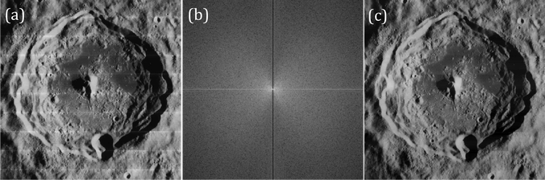
Improved lunar image from Lunar orbiter
The first image to be processed is from the Lunar Orbiter. It is a panorama with evident bright lines between each stitched frame. We want to eliminate these lines to render a smooth image. Notice that these horizontal lines occur periodically in the image. Therefore, its Fourier transform is composed of points along the y-axis. By blocking the signal along the y-axis of its transform, the result is a smooth picture as shown in figure 10c
Image from Lunar orbiter (a), its filtered Fourier transform (b) and the rendered image after filtering (c).
https://ghdoblado.wordpress.com/2016/10/13/properties-and-applications-of-2d-fourier-transform/

Slide 24
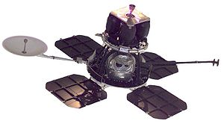
Lunar Orbiter Spacecraft (NASA)
The Lunar Orbiter program was a series of five unmanned lunar orbiter missions launched by the United States from 1966 through 1967.
Intended to help select Apollo landing sites by mapping the Moon's surface, they provided the first photographs from lunar orbit.
https://en.wikipedia.org/wiki/Lunar_Orbiter_program

Slide 25
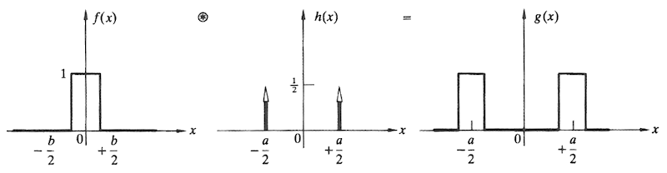
The convolution
Regarding the double slit, in practice, each aperture actually has some finite shape.
A method of convolution can be used to create a proper aperture function, e.g., actual double slit.
The aperture function g(x) is obtained by convolving the δ function spike h(x) , that locate each slit, with the rectangular pulse, f(x) that corresponding to the particular opening.
https://www4.uwsp.edu/physastr/kmenning/Phys385/Lect28.html

Slide 26
g(x) = f(x) ⊗ h(x) ?
By mathematical definition, the one-dimensional expression describing the convolution of two functions f(x) and h(x) is given as
What we are looking for is the resulting signal described by g(X).
To simplify the concept, we may consider the resulting signal at a particular point X₁.
The resulting signal g(X₁), at some point X₁ in the output space, is a linear superposition of all the individual overlapping contributions that exist at X₁.

Slide 27
Recall the convolution g(X),
Suppose the graph of h(X-x) can be described as
This suggests that with different x’s such as x = 0,…, x₁, x₂,…. The function h(X-x) is generated according to x value and shifted accordingly.
X
0
x₁
x₂

Slide 28
Therefore, the resulting signal g(X₁) can approximately be found from a linear superposition of all individual overlapping contributions that exist at X₁
In addition, the resulting signal g(X₂) can approximately be found from a linear superposition of all individual overlapping contributions that exist at X₂ and so on……
Finally, the complete signal of the convolution g(X) can be obtained.
In a more understandable statement, a convolution is the integral of all overlapping areas as one function scans another.
Notes:
The meaning of overlapping hear is from finding the resulting signal at X1 only.

Slide 29
This dashed curve is composed of points generated by f(x)h(0).
Each curve corresponds to the product of f(x)h(X-x) generated from different values of x.
This figure summarizes the process of the convolution described previously.

Slide 30
Convolution of two identical rectangular pulses (self convolution)
A rectangular pulse D scans an identical pulse and the overlap area is shaded at on point of the scanning.
The scanning pulse is represented by serval Dirac δ function and the component overlap areas are summed.
Note : when the number of
impulse functions is large the
sum of the components is
integrated to become the
triangular pulse.

Slide 31
τ
τ

Slide 32
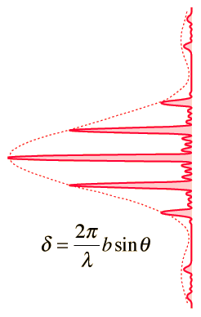
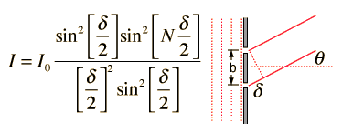
The convolution theorem (1)
When there are two transformations involving in a process, a convolution reduces this to a single transformation.
For example, consider the Fraunhofer diffraction of a grating.
The intensity of the diffraction pattern is clearly the two product functions,
one from a single slit and the other from the multiple slit interference (slit
with negligible width.
From multiple slit interference
From a single slit
http://hyperphysics.phy-astr.gsu.edu/hbase/phyopt/gratint.html#c1

Slide 33
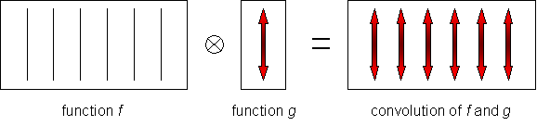
The convolution theorem (2)
https://www.doitpoms.ac.uk/tlplib/diffraction/convolution.php
Regarding the intensity of the diffraction pattern form the previous slide, these functions in the product are the Fourier transforms of their respective aperture functions.
This can actually be achieved by the convolution theorem which states that the Fourier transform of the convolution of two functions is the product of the Fourier transforms of individual functions.
Under this circumstance, this implies that the convolution of the single-slit aperture function with the array of line function gives the aperture function for the grating.
Function f
Function g
Convolution of f and g

Slide 34
An illustration of the convolution theorem

Slide 36
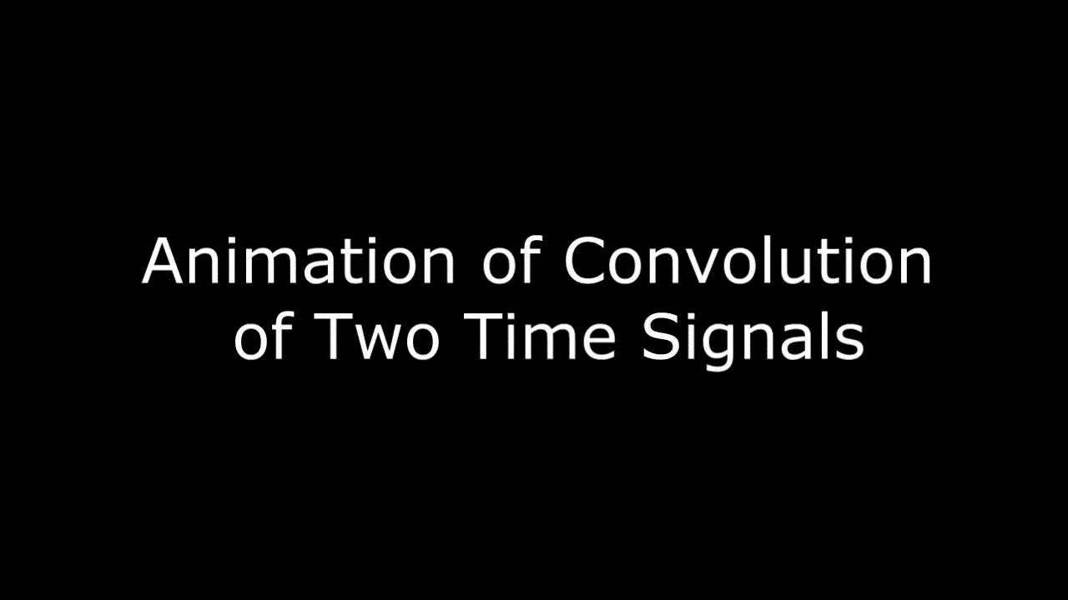
Fourier transforms of the two functions
the Fourier transform of the convolution of two functions is the product of the Fourier transforms of individual functions

Slide 37
